Slide 1
Security of Traffic Signal System

Slide 2
Present By
Rabbi Md Rasel ID:15-29419-1
Khondoker Md. Hasan ID:15-29388-1
Course Instructor:
MD. MASUDUZZAMAN

Slide 3
Content
Introduction.
Traffic Intersection.
Traffic Signal Network.
Problems.
Attacks.
Solutions.
Wireless Security.
Firewall.

Slide 4
Introduction
Traffic signals were originally designed as standalone hardware, but have evolved into more complex, networked system.
Traffic controllers now store multiple timing plans, integrate varied sensor data, and even communicate with other intersections in order to better coordinate traffic.
Its controlled by wireless network for mitigate cost, real time monitoring and coordination between adjacent intersections. But here discover several vulnerabilities in both the wireless network and the traffic light controller.
With coordination from the road agency, demonstrate several attacks against the deployment and are able to change the state of traffic lights on command.

Slide 5
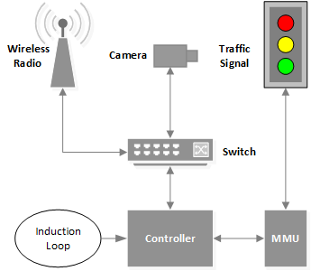
Traffic Intersection

Slide 6
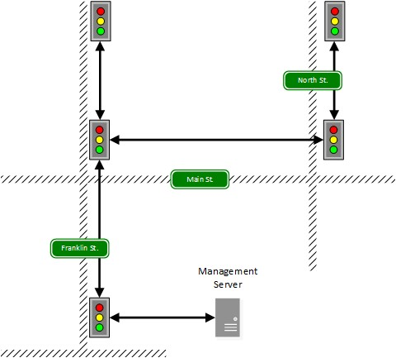
Traffic Signal Network
Lights networked in a tree
Data reporting only
Two communication bands
900 MHz
5.8 GHz
20 dBm with directional antennas

Slide 7
Problems
The network is accessible to attacker due to the lack of encryption.
Devices on the network lack secure authentication due to the default usernames and passwords.
To traffic controller is vulnerable known exploits.

Slide 8
Attacks
Threat Model.
Accessing The Networks.
Accessing the Controller.
Controlling the lights.
Denial Of Service.
Traffic Congestion.
Light Control.

Slide 9
Solutions
Wireless Security.
Firewall.
Firmware.
Changing Default Credentials.

Slide 10
Wireless Security
The 5.8 GHz radios used in the deployment are more vulnerable to attack than the 900 MHz radios. SSID broadcasting should be disabled on this network. While this does little to deter a determined adversary, it prevents casual observers and curious teenagers from noticing that the networks exist.
The 5.8 GHz radios support WPA2 encryption and it should be enabled in the field. The radios we examined only allow for encryption types of WEP or WPA to be enabled. Ideally, radios in the field should support WPA2 encryption, but enabling WPA is better than no encryption at all.
Enabling encryption on either type of radio requires establishing a set of encryption keys. These keys should be unique across each master and slave radio pair, but even a single key used across the entire network would provide more security than the current setup.

Slide 11
Firewall
If an attacker does manage to gain access to the network (wirelessly or physically), there are many vulnerabilities left open. To mitigate these attacks, we recommend re- configuring the radios and switch to put restrictions on network traffic whenever possible. Only necessary communications should be allowed through. Unused ports should be blocked entirely, preventing attacks such as accessing the debugger functionality on the controller.

Slide 12
Thanks…

